Slide 1
INT222
INTERNET ARCHITECTURE & Introduction to JavaScript continued

Slide 2
Internet Architecture
No one or organization owns the internet. The internet is a collection of networks connected to each other. The networks are connected together to form the single entity that we know as the Internet.
The name "INTERNET" comes from the two the words that describe the internet - interconnected networks.

Slide 3
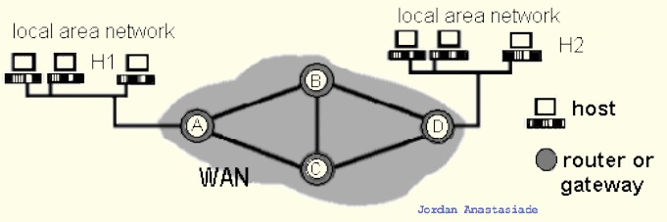
Elements of Networks
Communication links:
point-to-point (e.g., A-to-B)
broadcast (e.g.,: Ethernet LAN)
Host: computer running applications which use network (e.g. H1)
Router: computer routing packet from input line to output line. (e.g. C)
Gateway : a router directly connects networks (e.g. A)

Slide 4
Internet Protocol Suite
Communications protocol
a formal description of message formats
the rules for exchanging those messages
Internet Protocol Layers
Application layer (e.g. HTTP, FTP, Telnet, SMTP, DNS)
Transport layer
TCP (Transmission Control Protocol),
UDP (User Datagram Protocol)
Applications that do not require the reliability of a connection
Network layer : IP (Internet Protocol)
Physical and data link layers
e.g. Ethernet, token ring

Slide 5
Internet Application Protocols
Remote login category
Telnet
SSH, Secure Shell
File transfer category
FTP, File Transfer Protocol
SFTP, Secure File Transfer Protocol
Support services category
DNS, Domain Name System
SNMP, Simple Network Management Protocol
CMOT, Common Management Information Protocol
Electronic mail category
SMTP, Simple Mail Transfer Protocol
IMAP, Internet Message Access Protocol
POP, Post Office Protocol
Other protocols
HTTP, HyperText Transfer Protocol
LDAP, Lightweight Directory Access Protocol
NFS, Network File System
DHCP, Dynamic Host Configuration Protocol
IRC, Internet Relay Chat
…

Slide 6
Services Provided by the Internet
World Wide Web
Abbreviation: WWW or W3,
Commonly known as the Web.
It is a collection of web pages connected through hyperlinks and URLs.
With a web browser, one can view web pages that may contain text, images, videos, and other multimedia and navigate between them via hyperlinks.
It is governed by the Hyper Text Transfer Protocol (HTTP) that deals with the linking of files, documents and other resources of the web.
Other services:
Electronic Mail (email), Mailing List, File Transfer Protocol (FTP), Instant Messaging, News Groups, Chat Rooms

Slide 7
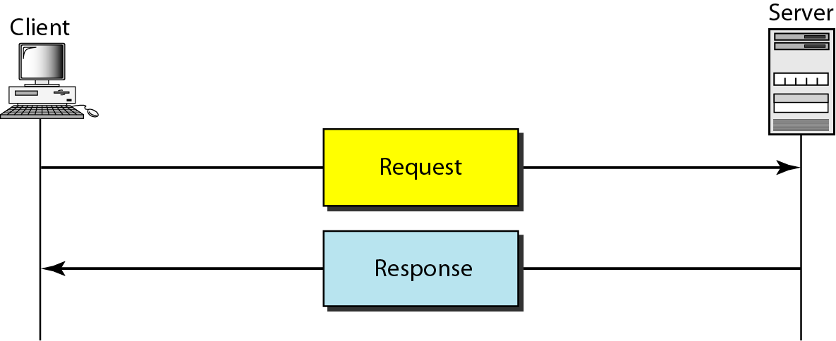
Client Server Model
The www uses a client-server model
client software (web browser) requests an html page
the request is sent as a message to the particular web server
requested page is sent as a message from the server to the client
the client software interprets and displays the html page

Slide 8
Uniform Resource Locators (URL)
Also known as a web address. It is a reference (an address) to a resource on the Internet.
https://ict.senecacollege.ca/index.php#program-types
protocol = https://
domain / host = ict.senecac.on.ca
port = 443, default for HTTPS
file / resource ID = index.php
reference = #program-types
URLs are typically transmitted via HTTP

Slide 9
HTML URL Encoding
URL encoding converts characters into a format that can be transmitted over the Internet.
URLs can only be sent over the Internet using the ASCII character-set.
URLs often contain characters outside the ASCII set
has to be converted into a valid ASCII format.
URLs cannot contain spaces.
Example: https://www.youtube.com/results?search_query=int222&feature=related
URL encoding replaces unsafe ASCII characters with a "%" followed by two hexadecimal digits. e.g.
'&' ⇨ %26 ' ' ⇨ %20
'<' ⇨ %3C '>' ⇨ %3E

Slide 10
DNS (Domain Name System/Server)
DNS is used to give names to IP addresses. DNS servers (name servers) associate the domain names with the IP address
e.g. zenit.senecac.on.ca is used to identify IP address 142.204.140.203.
In addition to ".ca", other common domains include
.com - commercial
.edu - educational
.gov - governmental
.net - isp
.org - non-profit
and many more
ICANN - Internet Corporation for Assigned Names and Numbers- oversees assignment of names and IP addresses and certifies domain name registrars to manage the process.

Slide 11
Hypertext Transfer Protocol
HTTP, the Hypertext Transfer Protocol, is the application-layer protocol that is used to transfer data on the (World Wide) Web.
HTTP comprises the rules governing the format and content of the conversation between a web client and server.
HTTP functions as a request-response protocol in the client-server computing model.
It follows a classical client-server model, with a client opening a connection, making a request then waiting for a response until it receives it.
HTTP is stateless.
The server doesn't keep any data (state) between two requests.

Slide 12
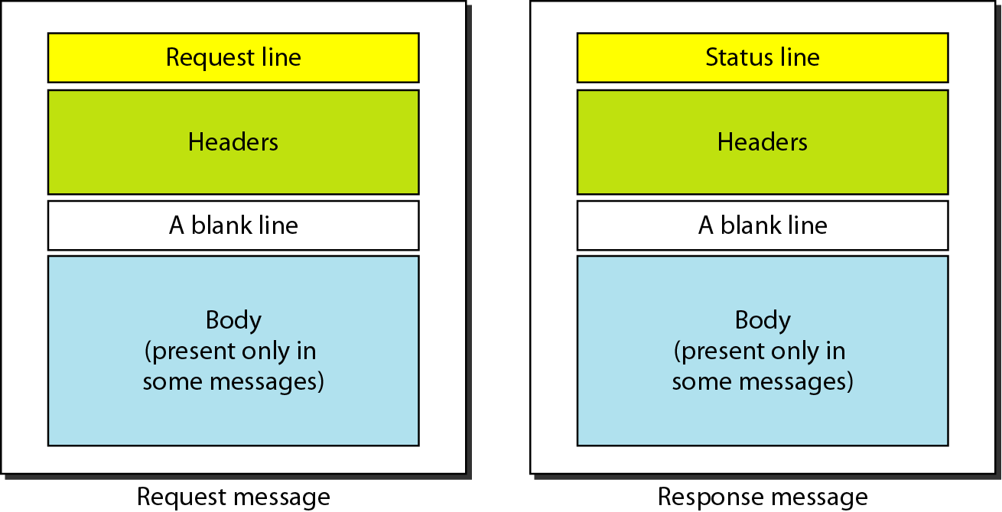
HTTP Request and Response Messages

Slide 13
HTTP Request
HTTP request example: sending the form result to a server:
POST /contact_form.php HTTP/1.1 Host: developer.mozilla.org Content-Length: 64 Content-Type: application/x-www-form-urlencoded name=Joe%20User&request=Send%20me%20one%20of%20your%20catalogue
HTTP request methods
GET, POST
PUT, DELETE, HEAD, TRACE

Slide 14
HTTP Response
HTTP response example: successful reception of a web page:
HTTP/1.1 200 OK Date: Sat, 09 Oct 2010 14:28:02 GMT Server: Apache Last-Modified: Tue, 01 Dec 2009 20:18:22 GMT ETag: "51142bc1-7449-479b075b2891b" Accept-Ranges: bytes Content-Length: 29769 Content-Type: text/html <!DOCTYPE html... (here comes the 29769 bytes of the requested web page)

Slide 15
HTTP Response Status Codes
1xx - information
2xx – success. e.g. 200 = request succeeded.
3xx - redirection
4xx – client error. e.g. 403 = forbidden page
5xx – server error. e.g. 500 = internal server error.

Slide 16
HTTP Secure
Hypertext Transfer Protocol Secure (HTTPS) is a communications protocol for secure communication over a computer network, with especially wide deployment on the Internet.
Technically, it is not a protocol in and of itself; rather, it is the result of simply layering the HTTP on top of the SSL(Secure Sockets Layer) / TLS(Transport Layer Security) protocol, thus adding the security capabilities of SSL/TLS to standard HTTP communications.

Slide 17
Web Application
A web application or web app:
A distributed application that uses Web-based technologies (and generally relies on Web browsers for the presentation of user-interfaces) is typically considered a Web application.
Update and maintain web applications without distributing and installing software on potentially thousands of client computers
inherent support for cross-platform compatibility.
Common web applications include:
Webmail, online retail sales, online auctions, wikis and more…

Slide 18
Front-end Web Application
The rising popularity of "modern" web apps means that web developers are focusing on writing more and more front-end, or client-side code.
Although back-end, or server-side code still plays an important factor, the fact is that web developers are working more directly with HTML5, CSS3, JavaScript and the DOM.

Slide 19
JavaScript – Getting Started
As you saw last class (notes available on My.Seneca) – JavaScript code can be embedded in an HTML document and executed in a web browser (Chrome, Firefox, Internet Explorer, etc).
Some important development tools that we will be using are:
Text editor – ie: Firefox Scratchpad
Web browser & Embedded “Dev Tools” – (Chrome developer tools, Firefox developer tools)
SFTP Program ie: FileZilla
JavaScript (Lint) [validator & error checker] - JSLint

Slide 20
Input & Output
JavaScript does not include input and output facilities. Its host environment (e.g. a browser) provides 2 input popup Boxes (Modal windows) :
prompt()
confirm()
as well as
console.log()

Slide 21
confirm()
Confirm box, needs user to verify or accept something.
Returns a boolean value: true or false
Example code:
var result = confirm("Are you OK?");
if (result) {
console.log ("You pressed OK!");
} else {
console.log ("You pressed Cancel!");
}

Slide 22
prompt()
Prompt box, displays a dialog box (Modal window) that prompts the user for input.
Returns a string entered by the user input; or return the value null.
Example code:
var cl = prompt("Enter your favorite color", "green");
if (cl) { // if cl is not null
console.log (cl);
}else{ // cl is null
console.log ("No color entered.");
}

Slide 23
console.log()
Shows a message in web console.
Outputs info.
Example code:
var anObject = { str: "Some text", id: 5 };
console.log(anObject);

Slide 24
Formal Introduction to JavaScript
JavaScript (sometimes shortened to JS) is a lightweight, interpreted, high-level language used along with html code.
The language syntax is somewhat similar but not the same as the C language. Today, JavaScript is the scripting language for Web pages.
JavaScript is not Java
An interpreted language interprets and executes each statement - one-by-one - in the order they appear.
JavaScript always runs inside a host environment (mostly the browser).
The JavaScript standard is based on the European Computer Manufacturers Association (ECMAScript). As of 2012, all modern browsers fully support ECMAScript 5.1.

Slide 25
JavaScript Intro – Cont’d
JavaScript is useful for making dynamic web pages, validating user input and changing the way the web page responds to events on the web page.
JavaScript statements can be stored in an external file with a .js file extension or embedded within HTML code (which is what we’ve been doing so far).
JavaScript is one of the world's most popular programming languages .
It is THE scripting language of the WWW.
It is comparatively simple and easy to learn
JavaScript is the world's most misunderstood programming language.
The name, typecasting, used by amateurs, object-oriented,…
The way things are going, JavaScript may be the most important language that you’ll learn

Slide 26
Basic JavaScript Rules
JavaScript is case-sensitive
When writing JavaScript, be aware of upper and lower case characters. CustomerCount is not the same as Customercount nor is it the same as customerCount
JavaScript statement
JavaScript (like C) typically consists of a series of statements. A statement is a single line of instruction to the computer – typically made up of objects, expressions, variables, and events/event handlers.
Command block
A Command block is a group of statements that is treated as a single entity and are grouped within braces - the curly brackets - { }

Slide 27
Basic JavaScript Rules – Cont’d
Matching Pairs
Opening and closing symbols need to work in pairs.
For example, if you use the left brace { to indicate the start of a command block, then you must use the right brace } to end the command block. The same matching pairs applies to single '......' and double "......." quotes to designate text strings.
The use of comments
Block/Multi-line comment: /* */
Single line comments: //
The use of white Space
JavaScript ignores extras spaces however it is recommended that you use them to make your scripts easier to read.

Slide 28
JavaScript data types
There are 3 main (primitive) data types:
string
must be enclosed in single or double quotes
number
can be integers or floating point
Special number: Infinity, NaN
boolean
values are binary, with the values (1) "true" and (0) "false" (without the quotes)
Other types:
undefined, null, object, function

Slide 29
JavaScript data types – Cont’d
JavaScript is a loosely typed language.
You do not have to specify the data type of a variable when you declare it (hence the “var” keyword that you have seen in the previous examples).
Data types are converted automatically as needed during script execution.

Slide 30
JavaScript Variables
Variable naming rules are: Must start with a letter, underscore (_), or dollar sign ($)
Cannot be a reserved (key) word
Subsequent characters can be letters
upper case (A...Z) or lower case (a...z),
numbers
underscores
JavaScript reserved words
Similar to other programming languages, JavaScript has a list of words that are considered "reserved".

Slide 31
Variables - Declare and Reference
You must use the "var" keyword to precede a variable name.
Unlike the C language, you do not need a type specifier.
The variable's initial value will set its initial type.
Declaration syntax:
Or:
Dynamic typing
a JavaScript variable can have a different type in different parts of a program
var variableName;
var variableName = "Summer";
// Referring to and using syntax:
variableName = 2015;
console.log(variableName);

Slide 32
Variables - Examples
Declaration | Type | Value
var identOne = "some text"; | String | some text
var identOne = 'some text'; | String | some text
var IdentOne = '172'; | String | 172
var _identOne = 25; | Number (Integer) | 25
var _identTwo = 56.2564; | Number (float) | 56.2564
var ident_A = true; | Boolean | true (1)
var ident_B = false; | Boolean | false (0)
var ident_C; | undefined | undefined
var ident_D="Yes", ident_E="No"; | String / String | Yes / No

Slide 33
Variables - Special Values
Infinity
Number Data Type
e.g. console.log(12/0);
NaN
Number Data Type
null
both a value and a data type
undefined
both a value and a data type
var x;
console.log(x);

Slide 34
Expressions
An expression is any valid set of literals, variables, operators, and expressions that evaluates to a single value.
The value may be a number, a string, or a logical value.
Two types of expressions:
those that assign a value to a variable, e.g. x = 7 .
those that simply have a value, e.g., 3 + 4 simply evaluates to 7; it does not perform an assignment.
JavaScript has the following kinds of expressions:
Arithmetic - evaluates to a number
String - evaluates to a character string
Logical - evaluates to true or false

Slide 35
Expressions - Ternary Operator
A conditional expression using the ternary operator (?:) can have one of two values based on a condition. The syntax:
(condition) ? val1 : val2;
If the condition is true, the expression has the value of val1, Otherwise it has the value of val2.
var status = (age >= 18) ? "adult" : "minor";

Slide 36
Arithmetic Operators
Operator | Operation | Example
+ | addition of numbers Concatenation of strings | y + x; “INT" + “222"
- | subtraction | x - y;
* | multiplication | x * y;
/ | division | x / y;
% | modulo | x % y; // remainder of x divided by y
++ | post/pre -increment | x = y++; // assign y to x, then increment y (y+=1) x = ++y; //increment y < (y+=1), then assign y to x
-- | post/pre decrement | x = y--; // assign y to x, then decrement y (y-=1) x = --y; // decrement y < (y-=1), then assign y to x

Slide 37
Arithmetic Operators - Assigning Values
Operator | Example | Equivalent | For
= | a = b; | a = b; | Numbers, strings, …
+= | a += b; | a = ( a + b); | numbers or strings
-= | a -= b; | a = ( a - b); | numbers
*= | a *= b; | a = ( a * b); | numbers
/= | a /= b; | a = ( a / b); | numbers
%= | a %= b; | a = ( a % b); // divide a by b, // assign remainder to a | numbers

Slide 38
Logical Operators
Let’s say: x = 2;
Operator | Operation | Example
&& | Logical AND | (x > 3 && x == 2) is false
|| | Logical OR | (true || x > 10 ) is true
! | Logical NOT | !(x ==2) is false

Slide 39
Comparison Operators
Operator | Description | Example
== | Equal (The operands are converted to the same type before being compared.) | 1 == 1 is true 1 == "1" is true 1 == true is true 0 == false is true
=== | strictly equal (There is no type conversion.) | 1 === 1 is true 1 === "1" is false 1 === true is false 0 === false is false
!= | not equal (with type conversion) | 1 != 1 is false 1 != '1' is false
!== | not equal (without type conversion) | 1 !== 1 is false 1 !== '1' is true
> | greater than | expr1 > expr2
>= | greater than or equal to | expr1 >= expr2
< | less than | expr1 < expr2
<= | less than or equal to | expr1 <= expr2

Slide 40
Other Operators
The typeof operator (for variable or values):
possible return values:
typeof "John" // Returns string
typeof 3.14 // Returns number
typeof false // Returns boolean
typeof [1,2,3,4] // Returns object
typeof {name:'John', age:34} // Returns object
The instanceof operator
Used for objects

Slide 41
Strings and Quotation Marks
Literal strings can be denoted by either single or double quotes, which gives you some flexibility about how to handle awkward situations such as quotation marks inside a string:
Expression | Values
"Let's start with JavaScript" | Let's start with JavaScript
'Not "it"!' | Not "it"!

Slide 42
Concatenation of Strings
The main operation on strings is the concatenation operator, +:
Expression | Value
"INT" + "222" | INT222
"Stephen" + " Harper" | Stephen Harper

Slide 43
Adding Strings and Numbers
x =5+5; console.log(x); // Output: 10
x="5"+"5"; console.log(x); // Output: 55
x=5+"5"; console.log(x); // Output: 55
x="5"+5; console.log(x); // Output: 55
NOTE: There’s an interesting little trick to do a simple conversion from a correctly formatted string to a number:
you can use the “Unary + operator”
x=5+ +"5"; console.log(x); // Output: 10
x=+"5"+5; console.log(x); // Output: 10

Slide 44
Example - Evaluating Expressions
var x = prompt("Enter a number.");
x = x + 2;
console.log("The value of x is " + x);
x = 2 * x;
console.log("The new value of x is now " + x);
x = x + 1;
console.log("x is now " + x);
console.log("x divided by 3 is: " + x/3);

Slide 45
Programming Constructs
JavaScript execution flow is determined using the following four (4) basic control structures:
Sequential: an instruction is executed when the previous one is finished.
Conditional a logical condition is used to determine which instruction will be executed next - similar to the "if" and "switch" statements in C.
Looping a series of instructions are repeatedly executed until some condition is satisfied - similar to the "for" and "while" statements in C.
Transfer jump to a different part of the code - similar to calling a function in C.

Slide 46
Construct (1) - Sequence
Tasks are executed one after another in “sequence” – ie:
var a = 3;
var b = 6;
var c = a + b;
console.log(c);

Slide 47
Construct (2) - Selection
Make decisions and perform single or multiple tasks based on the outcome of the decision (true or false).
Types of conditional statements :
if
if / else
switch / case

Slide 48
if-else Example
var grade, mark=prompt("Enter your mark:");
if (mark >= 90)
grade='A+';
else if (mark >= 80)
grade='A';
else if (mark >= 70)
grade='B';
else if (mark >= 60)
grade='C';
else if (mark >= 50)
grade='D';
else
grade="F";
console.log("Your grade: " + grade);

Slide 49
Switch-case Example
var semester = prompt("Enter CPD semester number (1 to 4)");
switch (semester) {
case '1':
console.log(“IPC144, ULI101");
break;
case '2':
console.log(“OOP244, INT222");
break;
case '3':
console.log(“DBS301, INT322");
break;
case '4':
console.log(“DCN455, JAC555");
break;
default:
console.log("You may have graduated from CPD");
break;
}

Slide 50
Construct (3) - Iteration
loop - an action that occurs again and again until a certain condition is met.
Continuously check a condition and based on the outcome, either terminate the loop or repeat a set of statements.
Three basic types of loop structures:
The for loop
The for / in loop
The while loop
The do-while loop

Slide 51
for loop Example
var days = "The days in September: \n";
for (var i = 1 ; i <= 30 ; i++) {
days += i + "\n";
}
console.log(days);

Slide 52
for in loop Example
Iterates over the enumerable properties of an object, in arbitrary order.
For each distinct property, statements can be executed.
var student = {name:"John", program:"CPD", semester:2};
var str = "Student info:\n\n";
for (var x in student) { // x is the current property ('key') – ie: name, program, or semester
str += x + ": " + student[x] + "\n";
}
console.log(str);

Slide 53
while & do…while loop Examples
// while loop
var text = "";
var i = 0;
while (i < 10) {
text += "\nThe number is " + i++;
}
console.log(text);
// do…while loop
var i = 10;
do {
console.log("week " + i++);
} while (i < 15)

Slide 54
break and continue Statements
break: breaks the loop and continue executing the code that follows after the loop (if any).
continue: breaks one iteration (in the loop), and continues with the next iteration in the loop.
var i=1;
while (i < 5){
console.log("week "+ i);
if (i==3)
break;
else
i++;
}
var i=1, j=1;
while (i < 5) {
console.log('week: '+ i );
for (j=1; j<=7; j++){
if (j==3) continue;
console.log('day: '+ j +' of week: '+ i);
}
i++;
}

Slide 55
Questions?
Any questions?
Would you like to see any more examples?

